Slide 1
Semantic Keyword Search Within the Medical Domain
Mauro Dragoni
Fondazione Bruno Kessler Process and Data Intelligence Research Unit
3rd KEYSTONE Summer School 21-25/08/2017 Wien, Austria

Slide 2
Outline
Brief introduction to ontologies
Use of semantic resources in information retrieval
without semantic annotations
with semantic annotations
Focus on the medical domain: why and how.
Material: https://goo.gl/CzFrsm

Slide 3
PART 1:
Brief introduction to ontologies.

Slide 4
Before to start…
What is an ontology?
What is a machine-readable dictionary?
What about ambiguity?
Terms vs. concepts, is everything clear?

Slide 5
What is an ontology?
“the branch of philosophy which deals with the nature and the organization of reality”
“an ontology is an explicit specification of a conceptualization” [Gruber1993]
conceptualization: abstract model of the world
explicit specification: model described by using unambiguous language
upper ontology (example: DOLCE [Guarino2002])
domain ontology

Slide 6
Ontology Components
Classes: entities describing objects having common characteristics (for example: “Agricultural Method”).
Individuals: entities that are instances of classes (for example “Multi Crops Farming” is an instance of “Agricultural Method”).
Properties: binary relations between entities (for example “IsAffectedBy”).
Attributes (or DataType Properties): characteristics that qualify individuals (for example “hasName”).

Slide 7
Hierarchies
Classes can be organized in subsumptions hierarchies
A sub-class might be also a super-class
Examples:
“Agricultural Method” is-a “Method”
“Intensive Farming” is-a “Agricultural Method”
Class hierarchies are generally represented by using tree structures

Slide 8
Attributes and Properties
Properties: binary relations between classes
Domain and range: classes to which individuals need to belong to be in relation
Definition: “Agricultural Method” <isAffectedBy> “Pollution” Instantiation: “Multi Crops Farming” <isAffectedBy> “Water Pollution”
Attributes: binary relations between an individual and values (not other entities)
Domain: class to which the attribute is applied
Range: the type of the value (for example “String”)
Properties and Attributes can be organized in hierarchies.

Slide 9
Steps for building an ontology
To identify the classes of the domain.
To organize them in a hierarchy.
To define properties and attributes.
To define individuals, if there are.
Notes:
A coarse roadmap. I leave you to the literature about methodologies for developing an ontology and about ontology design patterns.

Slide 10
Why ontologies are useful?
Ontologies provide:
a common dictionary of terms;
a formal interpretation of the domain.
Ontologies permit to:
solve ambiguities;
share knowledge (not only between humans, but also between machines);
use automatic reasoning techniques.

Slide 11
Use of ontologies in IR
Exploit metadata
Question Answering
“which president …” → “JFK is-a President”
Extraction of triples from text
applying NLP parsers for extracting dependencies
Notes:
…
At first stage, ontologies might be quite complex to integrate within an information retrieval system.
So, more “simple” resources can be used for practicing with the integration of textual and semantic information.

Slide 12
What is an thesaurus?
A “coarse” version of ontologies
Generally, 3 kinds of relations are represented:
hierarchical (generalization/specialization)
equivalence (synonymity)
associative (other kind of relationships)
Extensive resources used for query expansion approaches [Bhogal2007, Grootjen2006, Qiu1993, Mandala2000]
Notes:
[Mandala2000] Rila Mandala, Takenobu Tokunaga, Hozumi Tanaka: Query expansion using heterogeneous thesauri. Inf. Process. Manage. (IPM) 36(3):361-378 (2000)

Slide 13
Machine-readable dictionaries
A dictionary in an electronic form.
The power of MRD is characterized by word senses. [Kilgariff1997, Lakoff1987, Ruhl1989]
Identity of meaning: synonyms [Gove1973]
Inclusion of meaning: hyponymy or hyperonymy; troponymy [Cruse1986, Green2002, Fellbaum1998]
transitive relationship
Part-whole meaning: meronymy (has part), holonymy (part of) [Green2002, Cruse1986, Evens1986]
Opposite meaning: antonymy
Notes:
[Ruhl1989] C. Ruhl. On Monosemy: A study in linguistic semantics. State University of New York Press, Albany, NY, 1989.
[Gove1973] P.B. Gove. Webster’s New Dictionary of Synonyms. G. & C. Merriam Company, Springfield, MA, 1973.
[Cruse1986] A.D. Cruse. Lexical Semantics. Cambridge University Press, 1986.
[Green2002] R. Green, C.A. Bean, and S.H. Myaeng. The Semantics of Relationships: An Interdisciplinary Perspective. Cambridge University Press, 2002.
[Fellbaum1998] C. Fellbaum, editor. WordNet: An Electonic Lexical Database. MIT Press, 1998.
[Evens1986] M.W. Evens. Relational Models of the Lexicon. Cambridge University Press, 1986.

Slide 14
and now…
… let’s see how we can exploit these resources
within an information retrieval system…

Slide 15
PART 2:
Use of semantic resources
in information retrieval

Slide 16
Motivations and Challenges
How is information usually represented and classified?
Documents and Queries are represented using terms.
Indexing:
terms are extracted from each document;
terms frequency of each document is computed (TF);
terms frequency over the entire index is computed (IDF).
Searching:
the vector space model (or a customized version of it) is used to computed the similarity between documents and queries;
queries are generally expanded to increase the recall of the system.

Slide 17
Drawbacks of the Term-Based representation – 1/2
The “semantic connections” between terms in documents and queries are not considered.
Different vector positions may be allocated to the synonyms of the same term:
the importance of a specific concept is distributed among different vector components → information loss.

Slide 18
Drawbacks of the Term-Based representation – 2/2
The query expansion has to be used carefully.
It is more easy to increase the recall of a system with respect to its precision. Which is better? [Abdelali2007]
In the worst case, the size of a document vector could be close to the number of terms used in the repository:
in general, the number of concepts is less than the number of words;
the time needed to compare documents is higher.

Slide 19
Intuition Behind
Using concepts (in particular WordNet’s synsets) to represent the terms contained in documents and queries. [Dragoni2012b]
Documents and Queries may be represented in the same way.
The size of a concept vector is generally smaller than the size of a term vector.
The issue related to how many and which terms have to be used for query expansion is not considered.
IMPORTANT: This is not a query expansion technique !!!

Slide 20
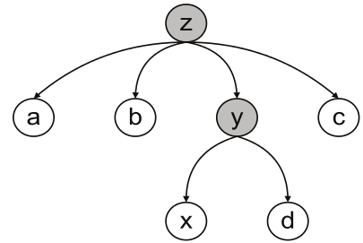
a first simple example …
a close vocabulary:

Slide 21
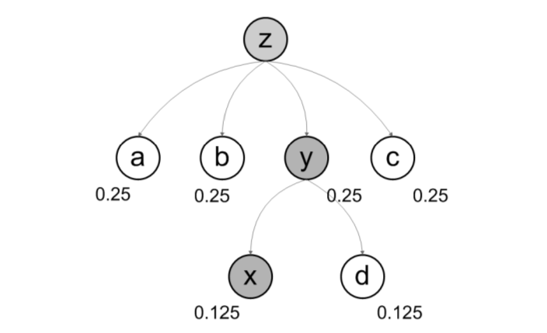
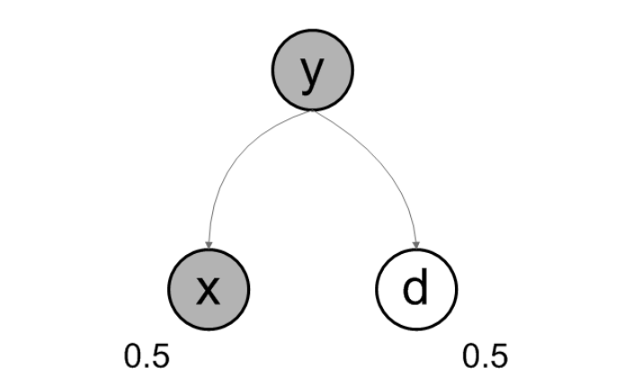
a first simple example …
a close vocabulary:

Slide 22
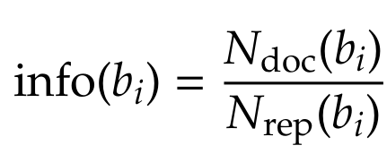
a first simple example …
how to compute concepts’ weight?

Slide 23
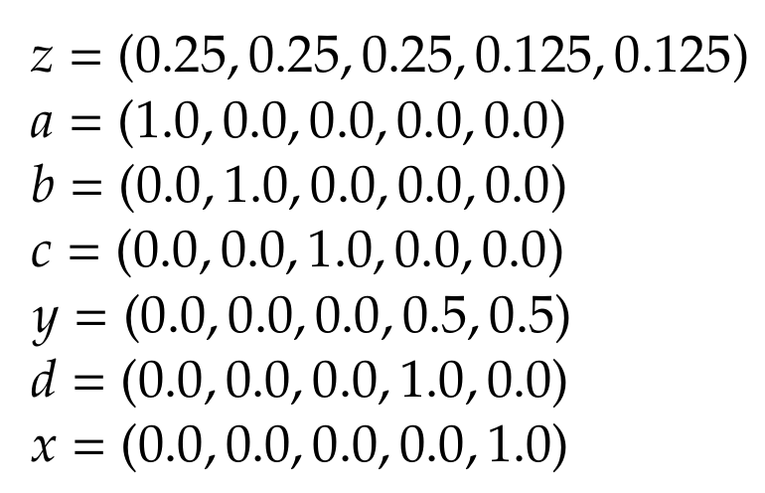
a first simple example …
how is each concept of the vocabulary represented?
for example the document D₁: “x x y y y z”

Slide 24
… that we evaluated
Experiments on the TREC Ad-Hoc Collection:
Results have been compared with the IRS presented at TREC-7 and TREC-8 conference
Only the systems that implements a semantic representation of queries have been considered.
Over dozens of runs, the three systems that performs better at recall 0.1 have been chosen. [Spink2006]

Slide 25
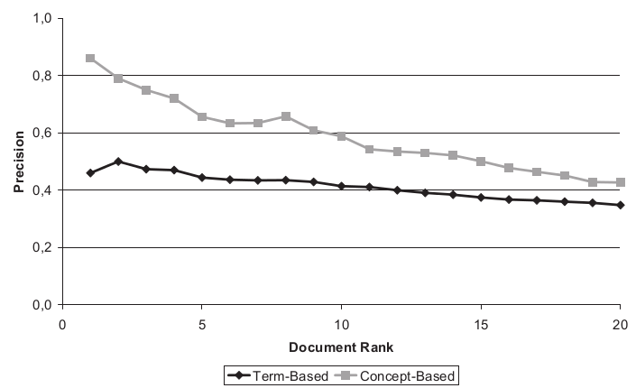
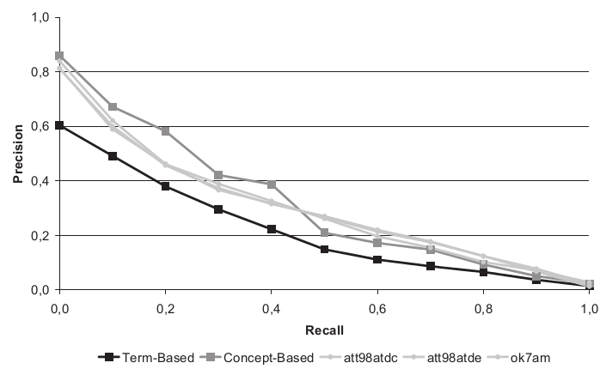
TREC-7
System | P@5 | P@10 | P@15 | P@30 | MAP
Term-Based | 0.444 | 0.414 | 0.375 | 0.348 | 0.199
AT&T Labs 1 | 0.644 | 0.558 | 0.499 | 0.419 | 0.296
AT&T Labs 2 | 0.644 | 0.558 | 0.497 | 0.413 | 0.294
City University, Sheffield, Microsoft | 0.572 | 0.542 | 0.507 | 0.412 | 0.288
Ontology Indexing | 0.656 | 0.588 | 0.501 | 0.397 | 0.309

Slide 26
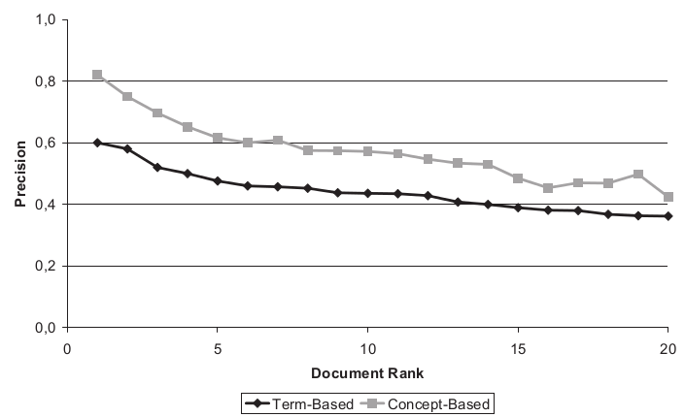
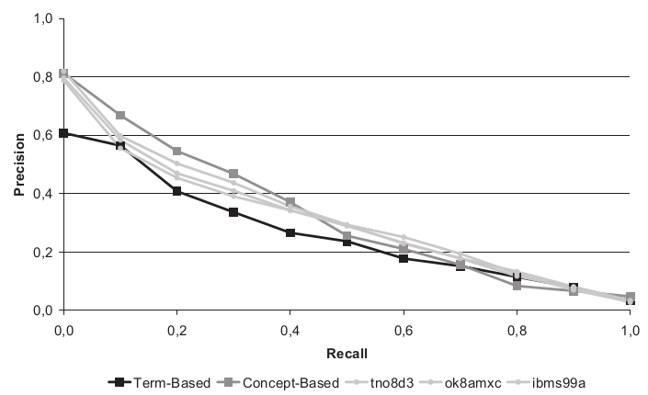
TREC-8
System | P@5 | P@10 | P@15 | P@30 | MAP
Term-Based | 0.476 | 0.436 | 0.389 | 0.362 | 0.243
IBM Watson | 0.588 | 0.504 | 0.472 | 0.410 | 0.301
Microsoft Research | 0.580 | 0.550 | 0.499 | 0.425 | 0.317
TwentyOne | 0.500 | 0.454 | 0.433 | 0.368 | 0.292
Ontology Indexing | 0.616 | 0.572 | 0.485 | 0.415 | 0.315

Slide 27
Some considerations
Two drawbacks have been identified:
The absence of some terms in the ontology, (in particular terms related to specific domains like biomedical, mechanical, business, etc.), may affect the final retrieval result.
a more complete knowledge base is needed.
Term ambiguity. By using a Word Sense Disambiguation approach, concepts associated with incorrect senses would be discarded or weighted less.
a Word Sense Disambiguation algorithm is required: but it has to be used carefully.

Slide 28
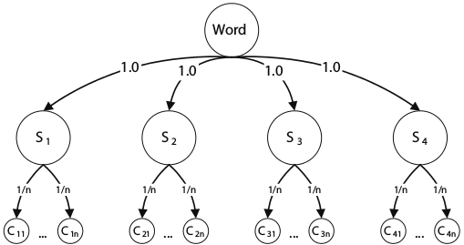
Few words on disambiguation

Slide 29
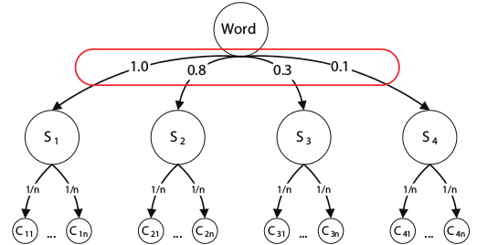
Few words on disambiguation

Slide 30
Checkpoint
the use of thesauri or machine-readable dictionaries is suitable for implementing a first semantic engine
but by using ontologies we might access to more information
properties
attributes
the problem is: how can we exploit all these information?

Slide 31
Ontology enhanced IR
Enrichment of documents (and queries) with information coming from semantic resources
information expansion: adding synonyms, antonyms, … not new but still helpful
annotations: relation or association between a semantic entity and a document
Most of the information expansion systems are based on WordNet and the Roget’s Thesaurus
Systems using annotations are connected with the Linked Open Data cloud, and mainly with Freebase and Wikipedia

Slide 32
Classification of Semantic IR approaches
Criterion | Approaches
Semantic knowledge representation | Statistical [Deerwester1990] Linguistic conceptualization [Gonzalo1998, Mandala1998, Giunchiglia2009] Ontology-based [Guha2003, Popov2004]
Scope | Web search [Finin2005,Fernandez2008] Limited domain repositories [Popov2004] Desktop search [Chirita2005]
Query | Keyword query [Guha2003] Natural language query [Lopez2009] Controlled natural language query [Bernstein2006, Cohen2003] Structured query based on ontology query language [notes]
Content retrieved | Data retrieval Information retrieval
Content ranking | No ranking Keyword-based ranking [Guha2003] Semantic-based ranking [Stojanovic2003]
Notes:
http://www.w3.org/Submission/RDQL/
http://www.w3.org/TR/rdf-sparql-query/

Slide 33
Limitation of Semantic IR approaches – 1/2
Criterion | Limitation | IR | Semantic
Semantic knowledge representation | No exploitation of the full potential of an ontological language, beyond those that could be reduced to conventional classification schemes. | x | (Partially)
Scope | No scalability to large and heterogeneous repositories of documents. |  | x
Goal | Boolean retrieval models where the Information Retrieval problem is reduced to a data retrieval task. |  | x
Query | Limited usability |  | x

Slide 34
Limitation of Semantic IR approaches – 2/2
Criterion | Limitation | IR | Semantic
Content retrieved | Focus on textual content: no management of different formats (multimedia) | (Partially) | (Partially)
Content ranking | Lack of semantic ranking criterion. The ranking (if provided relies on keyword-based approaches. | x | x
Coverage | Knowledge incompleteness. [Croft1986] | (Partially) | x
Evaluation | Lack of standard evaluation frameworks. [Giunchiglia2009] |  | x

Slide 35
A basic ontology-based IR model
SPARQL Editor
SPARQL
Query
Query Processing
User
Semantic Entities
Ranking
Searching
Unsorted Documents
Semantic Index (weighted annotations)
Ranked Documents
Ontology
Indexing
Document Corpus
Notes:
[Yates1999] R. Baeza Yates, B. Ribeiro Neto, Modern Information Retrieval, Addison-Wesley, Harlow, UK, 1999.
[Fernandez2011]

Slide 36
Basic ontology-based IR model - Limits
Heterogeneity
a single ontology (but also a set of them) cannot cover all possible domains
Scalability
imagine to annotate the Web by using all knowledge bases currently available
a final solution does not exist… but nice and practical approaches can be used
Usability
are all the people you know able to write SPARQL queries?

Slide 37
Extended ontology-based IR model
Nat. Lang. Interface
Natural Lang.
Query
Query Processing
Entity Mapping
User
Ranking
Searching
Semantic Entities
Unsorted Documents
Semantic Index (weighted annotations)
Ranked Documents
Semantic Web
Preprocessed Semantic Knowledge
Indexing
Unstructured Web contents

Slide 38
A focus on the indexing procedure
Challenge: to link semantic knowledge with documents and queries in an efficient and effective way:
document corpus and semantic knowledge should remain decoupled;
annotations have to be provided in a flexible and scalable way.
Annotations can be provided in two ways:
by applying an information extraction strategy based on pure NLP approaches;
by applying a contextual semantic information approach.

Slide 39
Natural Language Processing Annotation
<html>
<body>
<p>Schizophrenia patients whose medication couldn’t stop
the imaginary voices in their heads</p>
</body>
</html>
HTML Parser
NLP
Tools
Schizophrenia patients whose medication couldn’t stop the imaginary voices in their heads
<document><p><s>
<w c=“w” pos=“NNP” lemma=“Schizophrenia”>Schizophrenia</w>
<w c=“w” pos=“NN$” lemma=“patient”>patients</w>
<w c=“w” pos=“WP$”>whose</w>
<w c=“w” pos=“NN” lemma=“medication”>medications</w>
<w c=“w” pos=“MD”>could</w><w c=“w” pos=“RB”>not</w>
<w c=“w” pos=“VB” lemma=“stop”>stop</w>
<w c=“w” pos=“DT”>the</w>
<w c=“w” pos=“JJ”>imaginary</w>
<w c=“w” pos=“NN$” lemma=“voice”>voices</w>
<w c=“w” pos=“IN”>in</w>
<w c=“w” pos=“PRP$”>their</w>
<w c=“w” pos=“NN$” lemma=“head”>heads</w>
</s></p></document>
Token Filter
schizophrenia
patient
medication
stop
voice
head

Slide 40
Natural Language Processing Annotation
Keyword | Ontology Entities
schizophrenia | E1
patient | E4, E5
… | …
head | E2, E8
schizophrenia
patient
medication
stop
voice
head
Index Searcher
Ontology Entity | Document Frequencies
E1 | D1(1), D4(2)
… | …
E8 | D1(1), D5(4), D6(3)
Frequency Counter
Ontology Entity | Document | Weight
E1 | D1 | 0.9
… | …
E8 | D1 | 0.3
Annotation Creator

Slide 41
Contextual Semantic Annotation
Selection of a semantic entity
Ontology
E1: Individual Maradona;
Labels: {“Maradona”, “Diego Maradona”, “Pelusa”}
Selection of the semantic context
Search of terms in the document index
E34 = Class: football_player
Labels:{“football player”}
E22 = Individual: Argentina
Labels:{“Argentina”}
Keyword | Documents
Maradona | D1, D2, D87
Pelusa | D95, D140
football_player | D87, D61, D44, D1
Argentina | D43, D32, D2
Selection of contextualized terms in the document index
Potential documents to annotate
{D1, D2, D87, D95, D140}
Contextualized documents
{D1, D2, D32, D43, D44, D61, D87}

Slide 42
Contextual Semantic Annotation
Potential documents to annotate
{D1, D2, D87, D95, D140}
Contextualized documents
{D1, D2, D32, D43, D44, D61, D87}
Selection of semantic contextualized documents
Documents to annotate
{D1, D2, D87}
Creation of annotations
Ontology Entity | Document | Weight
E1 | D1 | 0.5
E1 | D2 | 0.2
E1 | D87 | 0.67
Notes:
[Aquin2007]
[Aquin2007b]
[Castells2007]

Slide 43
A Second Case Study – The Scenario
Keyword search over a multi-layer representation of documents
Documents and queries structure:
Textual layer: natural language text
Metadata layers:
Entity Linking
Predicates
Roles
Timing Information
Problems:
How to compute the score for each layer?
How to aggregate such scores?
How to weight each layer?

Slide 44
A Second Case Study – The Scenario
Natural language content is enriched with four metadata/semantic layers extracted with PIKES (https://pikes.fbk.eu)
URI Layer: links with entities detected into the text and mapped to DBpedia entities
TYPE Layer: conceptual classification of the named entities detected into the text and mapped with both DBpedia and Yago knowledge bases
TIME Layer: metadata related to the temporal mentions find into the text by using a temporal expression recognizer (ex. “the eighteenth century”, “2015-18-12”, etc.)
FRAME Layer: output of the application of semantic role labeling techniques. Generally, this output includes predicates and their arguments describing a specific role in the context of the predicate. Example: “He has been influenced by Carl Gauss” → [framebase:Subjective_influence; dbpedia:Carl_Friedrich_Gauss]

Slide 45
A Second Case Study - Evaluation
331 documents, 35 queries
Multi-value relevance (1=irrelevant, 5=relevant)
Different kind of queries: from keyword-base search to queries requiring semantic capabilities

Slide 46
A Second Case Study - Evaluation
2 baselines:
Google custom search API
Textual layer only (~Lucene)
Measures: Prec1,5,10, MAP, MAP10, NDCG, NDCG10
Same weights for textual and semantic layers:
TEXTUAL (50%)
URI (12,5%), TYPE (12,5%), FRAME (12,5%), TIME (12,5%)
Notes:
...
We decided to assign the same importance to the textual and the semantic information and the weight of the semantic information has been split equally across the four semantic layers.
Keep in mind this thing… I will discuss about weights in the last part of the tutorial.

Slide 47
A Second Case Study - Evaluation
Approach/ System | Prec1 | Prec5 | Prec10 | NDCG | NDCG10 | MAP | MAP10
Google | 0.543 | 0.411 | 0.343 | 0.434 | 0.405 | 0.255 | 0.219
Textual | 0.943 | 0.669 | 0.453 | 0.832 | 0.782 | 0.733 | 0.681
KE4IR | 0.971 | 0.680 | 0.474 | 0.854 | 0.806 | 0.758 | 0.713
KE4IR vs. Textual | 3.03% | 1.71% | 4.55% | 2.64% | 2.99% | 3.50% | 4.74%
Notes:
…
we saw this morning how search engines focus on recall than the precision…

Slide 48
A Second Case Study - Evaluation
Layers (TEXTUAL+) | Prec1 | Prec5 | Prec10 | NDCG | NDCG10 | MAP | MAP10
URI,TYPE,FRAME,TIME | 0.971 | 0.680 | 0.474 | 0.854 | 0.806 | 0.758 | 0.713
URI,TYPE,FRAME | 0.971 | 0.680 | 0.474 | 0.853 | 0.804 | 0.757 | 0.712
URI,TYPE,TIME | 0.971 | 0.680 | 0.474 | 0.851 | 0.802 | 0.757 | 0.712
URI,TYPE | 0.971 | 0.680 | 0.474 | 0.849 | 0.801 | 0.755 | 0.710
URI,FRAME,TIME | 0.971 | 0.674 | 0.465 | 0.844 | 0.796 | 0.750 | 0.702
URI,FRAME | 0.971 | 0.674 | 0.465 | 0.842 | 0.795 | 0.749 | 0.702
URI,TIME | 0.971 | 0.674 | 0.465 | 0.840 | 0.791 | 0.747 | 0.700
TYPE,FRAME,TIME | 0.943 | 0.674 | 0.471 | 0.848 | 0.799 | 0.745 | 0.700
TYPE,TIME | 0.943 | 0.674 | 0.471 | 0.843 | 0.794 | 0.743 | 0.697
TYPE,FRAME | 0.943 | 0.674 | 0.468 | 0.847 | 0.797 | 0.743 | 0.695
FRAME,TIME | 0.943 | 0.674 | 0.462 | 0.842 | 0.793 | 0.741 | 0.693

Slide 49
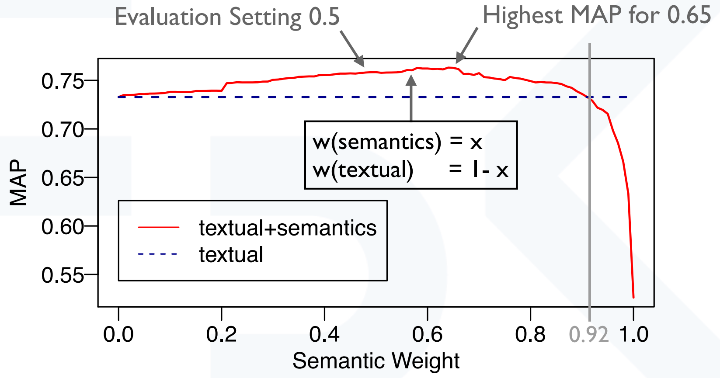
A Second Case Study - Evaluation
Notes:
Yes, semantic may help the retrieval process…

Slide 50
Case Study – What We Learnt
How weights change may affect system effectiveness.
In this specific case, the use of a weight schema helps you in balancing the importance of the semantic information.
Further lessons more related to the use of semantic layers and resources…

Slide 51
PART 3:
Focus on the medical domain:
why and how.

Slide 52
From general purpose to domain specific
Previously: how to integrate general purpose knowledge bases into an information retrieval system.
To build an effective semantic based information retrieval system, there is a preliminary checklist to verify:
do you have high-quality semantic resources to use for annotating your documents?
are these resources freely available and maintained?
have these resources a good coverage of all information available in the repository?
Thus: be careful in selecting your resources!
Notes:
…
the context is very important (story about CNR guy that has to go to San Jose…)

Slide 53
From general purpose to domain specific
As example: Is DBpedia a good candidate?
You may encounter several problems in resources built automatically.
Issues contained in DBpedia:
entities classified as person and organization at the same time;
functional properties that have different values in different chapters;
domain/range axioms that cannot be used for doing inferences;
incorrect sameAs properties;
Wikipedia pages representing lists that are classified as dbo:Person
Notes:
…
the context is very important (story about CNR guy that has to go to San Jose…)

Slide 54
From general purpose to domain specific
A good strategy:
to start with domain specific resources for understanding how everything works and for performing a more clear evaluation of your systems.
Two examples of very well structures resources:
Agrovoc → Domains of food, nutrition, agriculture, fisheries, forestry, environment.
UMLS → Medical domain.
Both resources have been built and verified manually.
Notes:
…
the context is very important (story about CNR guy that has to go to San Jose…)

Slide 55
Focus on the medical domain: UMLS Knowledge Base
Link: https://www.nlm.nih.gov/research/umls/
Content:
205 resources (taxonomies, thesaurus, vocabularies, etc.);
alignments between resources;
semantic networks (next slide);
66 of them are multilingual;
complete coverage of the medical domain.
Don’t worry, for the Hackathon I simplified your life and only the MeSH resource will be used… ☺
Notes:
…
the context is very important (story about CNR guy that has to go to San Jose…)

Slide 56
Focus on the medical domain: UMLS Knowledge Base
Semantic Networks
Broad subject categories, or semantic types
organism, anatomical structure, biologic function, chemical, physical object, etc.
A set of relationships, or semantic relations
physically related to
spatially related to
temporally related to
functionally related to
conceptually related to
Notes:
…
… providing a consistent categorization of all concepts
… existing between semantic types

Slide 57
Our approach for Semantic Medical IR
Step 1: to support document annotation.
Step 2: to build the multilayer document representation.
Step 3: to develop the ranking algorithm.
Notes:
…
the context is very important (story about CNR guy that has to go to San Jose…)

Slide 58
Step 1: Document Annotation
For each concept “C” of the knowledge base:
label
description
label and description of concepts directly connected with “C”
All information have been indexed in Lucene
From each document all sentences have been extracted
Each sentence (once polished) have been used as query for retrieving candidate annotations.
Notes:
Also the sameAs relation is important here due to the possibility of accessing to further labels and definitions of the same concept.
Medical terms can be easily identified by using this strategy.

Slide 59
Step 2: Multilayer Representation
Each document contains abstract and content.
Both abstract and content are annotated.
Four layers:
abstract
abstract-annotations
content
content-annotations
Notes:
…
the context is very important (story about CNR guy that has to go to San Jose…)

Slide 60
Step 3: Ranking Algorithm
Queries are annotated by using the same strategy (and the same resource)
Each query can be (eventually) separated in subqueries and performed in different steps.
different queries for each layer
different queries if the layers are annotated or not
→ Total: 4 queries.
The resulting ranks have been aggregated.
Notes:
…
the context is very important (story about CNR guy that has to go to San Jose…)

Slide 61
An idea for rank aggregation
Assignment of priorities to each layer → “criterion”
Compute criteria weights
Weight of criteria with low priority depends on the score of criteria with high priority
Aggregate criteria scores [Dragoni2012]
Notes:
…
the context is very important (story about CNR guy that has to go to San Jose…)

Slide 62
Multicriteria Ranking Problem Representation
Components
the set C of the n considered criteria: C = {C₁, …, C_{n}};
the collection D of entities (documents in the specific case of IR);
an aggregation function F computing the score F(C₁(d),…, C_{n}(d)) of each document d contained in D;
a priority model defined by… someone (user, system maintainer, etc.);
a weighting schema W.

Slide 63
Weighting Schema – Expert-based choices
Weights are arbitrarily chosen by an expert.
For example:
C$1$ → λ₁ = 0.7
C₂ → λ₂ = 0.5
C₃ → λ₃ = 0.6
C₄ → λ₄ = 0.3
You need to justify the values you choose.

Slide 64
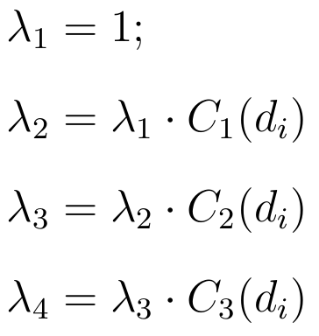
Weighting Schema – Priority-based choice
Weights are computed “automatically” based on the priority between criteria.
For each document d, the weight of the most important criterion C₁ is set to 1.0 by definition.
The weights of the other criteria are computed as follows:

Slide 65
Weight Schema - Considerations
A weighting schema can be decided a-priori but…
We can learn a new weighting schema:
from learn-to-rank dataset, or
from the IR system usage.
The choice of the weighting schema, obviously, affects the effectiveness of your information retrieval system.

Slide 66
Three (not exhaustive) Operators
As you can imagine… there are different ways for combining weights and criteria
Operator 1: “Sum”
weighted criteria scores are summed
Operator 2: “Min” or “And”
among weighted criteria scores, minimum score is selected
Operator 3: “Max” or “Or”
among weighted criteria scores, maximum score is selected

Slide 67
The “Sum” Operator
The overall document score is computed by aggregating the weighted scores computed for all criteria.
The score computed on the most important criterion leads the overall document score.
Less important criteria help in refining the overall document score.

Slide 68
The “And” (or “Min”) Operator
The document score is strongly dependent on the degree of satisfaction of the least satisfied criterion
Very restrictive operator
Suggestion: consider criteria that are really relevant for a user!!!

Slide 69
The “Or” (or “Max”) Operator
Dangerous operator!
Recommendation: criteria with a satisfaction degree of zero do not have to be considered.
It is useful only when priority between criteria is not used.
Weighting schema is manually defined
Weight of less important criteria are not based on the value of the most important ones.

Slide 70
Evaluating different strategies
Two combination of layers:
Abstract + Content
Abstract + Content + Annotations
For each combination, we tested all operators.
Sum
Min
Max
Notes:
…
the context is very important (story about CNR guy that has to go to San Jose…)

Slide 71
Results
System | P@5 | P@10 | P@30 | MAP
Abstract + Content (Sum) | 0.614 | 0.518 | 0.423 | 0.272
Abstract + Content (Min) | 0.614 | 0.518 | 0.389 | 0.286
Abstract + Content (Max) | 0.463 | 0.399 | 0.238 | 0.147
Abstract + Content + Annotations (Sum) | 0.671 | 0.545 | 0.462 | 0.305
Abstract + Content + Annotations (Min) | 0.715 | 0.586 | 0.332 | 0.298
Abstract + Content + Annotations (Max) | 0.572 | 0.442 | 0.212 | 0.118
Notes:
…
the context is very important (story about CNR guy that has to go to San Jose…)

Slide 72
What we learnt?
The use of different aggregation schema may significantly impact on the system effectiveness.
Using a conservative strategy may lead to better results for top-10 positions.
Semantic annotations can boost the system effectiveness but do not expect to find a perfect system.
Notes:
…
the context is very important (story about CNR guy that has to go to San Jose…)

Slide 73
Summary and final remarks
Ontologies in IR is still a controversial topic due to the different quality of semantic resources.
Personal Opinion: to combine structured and unstructured representation seems to be the most suitable solution.
Pay attention to the kind of queries performed by users.
Aggregation of results.
Do you want to be brave? Try to work with triples and embeddings!
Notes:
…
the context is very important (story about CNR guy that has to go to San Jose…)

Slide 74
Mauro Dragoni Fondazione Bruno Kessler https://pdi.fbk.eu/index.php/Mauro_Dragoni dragoni@fbk.eu

Slide 75
Annotator Requirements
Identification of the entities within the documents
conceptually, it is not so much different w.r.t. a traditional IR indexing process
Ontologies must not be touched (decoupling)
Should be open-domain
Scalable-friendly:
indexing of ontologies;
indexing of documents;
an interesting alternative: usage of non-embedded annotations

Slide 76
A Second Case Study – Example
Text: “astronomers influenced by Gauss”
Layers
URI Layer: “dbpedia:Carl_Friedrich_Gauss”
TYPE Layer: “yago:GermanMathematicians”, “yago:NumberTheorists”, “yago:FellowsOfTheRoyalSociety”
TIME Layer: “day:1777-04-30”, “day:1855-02-23”, “century:1700”
FRAME Layer: “Subjective_influence.v_Carl_Friedrich_Gauss”

