Slide 1
Title
Welcome
author

Slide 2
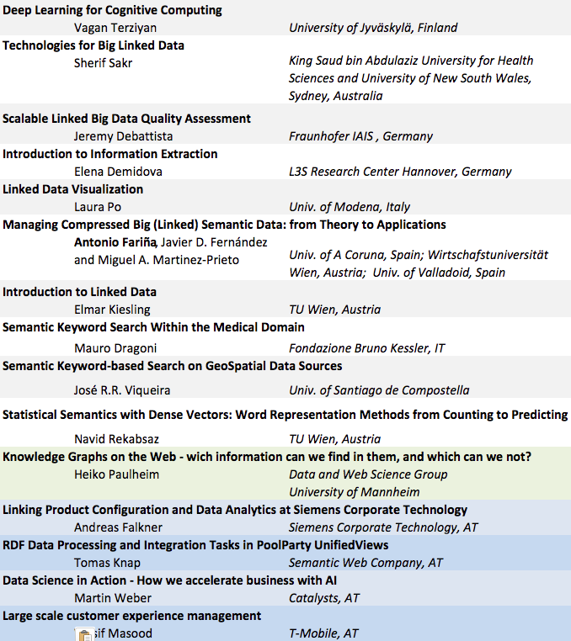

Slide 3
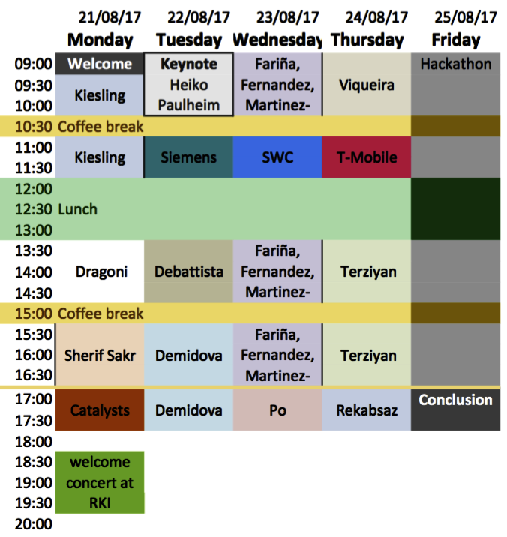
title
text

Slide 4
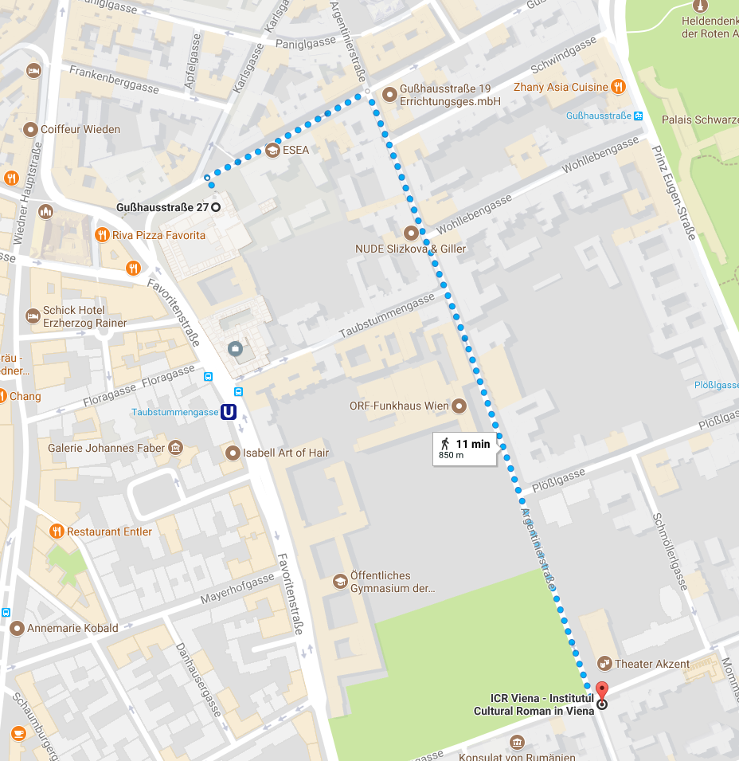
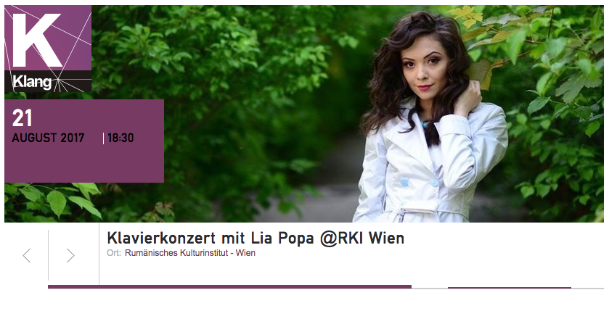
18:30

Slide 5
KnowledgeFox
https://keystone.knowledgefox.net
https://knowledgefox.net

Slide 6
KEYSTONE Hackathon
Mauro Dragoni
Fondazione Bruno Kessler Process and Data Intelligence Research Unit
3rd KEYSTONE Summer School 21-25/08/2017 Wien, Austria

Slide 7
Hackathon Structure
Task #1: Document Retrieval
Documents: ~733,000 documents belonging to the medical domain (Set #1)
Topics: 50 topics
Task #2: Document Annotation (or Classification)
Documents: ~10,000 documents belonging to the medical domain (Set #2)
Ontology: MeSH classification schema
Training material: a set of metadata associated with the documents contained in Set #1

Slide 8
Hackathon Timeline
[last week]: you received via mail Set #1, the MeSH ontology, and a set of annotations (or classifications) associated with part of Set #1.
[today]: group creation.
[late Thursday]: you will receive the topics for Task #1 and document Set #2 for completing Task #2.
Azure account codes will be distributed
[Friday]: Hackathon day.
[Friday afternoon]: you have to sent the results of your system at the following email addresses:
dragoni@fbk.eu
mihai.lupu@tuwien.ac.at

Slide 9
Task #1 – Results File
The file name has to be: task1-results.txt
File format (single space separator between fields):
TOPIC_NO Q0 DOCID RANK SCORE GROUP_NAME
Example (documents have to be ordered by SCORE):
1 Q0 2627657 1 0.914 IRPRIDE
1 Q0 2412855 2 0.882 IRPRIDE
1 Q0 3320002 3 0.648 IRPRIDE
1 Q0 2836992 4 0.487 IRPRIDE
1 Q0 2858129 5 0.144 IRPRIDE

Slide 10
Task #2 – Results File
The file name has to be: task2-results.txt
File format (single space separator between fields):
DOCID MESHID GROUP_NAME
Example:
2627657 B01.050 IRPRIDE
2627657 B01.650 IRPRIDE
3320002 G05.695 IRPRIDE
…

Slide 11
Hackathon - Evaluation
Task #1
Precision, recall, and mean average precision will be measured.
Systems will be ranked by MAP.
Task #2
Precision, recall and f-measure will be measured
Systems will be ranked F-MEASURE.

Slide 12
Thank you
Enjoy!

